Slide 1
EfficientViT zerlegt
But only the attention mechanism part proposed in
https://arxiv.org/pdf/2305.07027
and conducted in
http://vclab.science.uoit.ca/pubs/25-arxiv-j-cascaded-vit.pdf

Slide 4
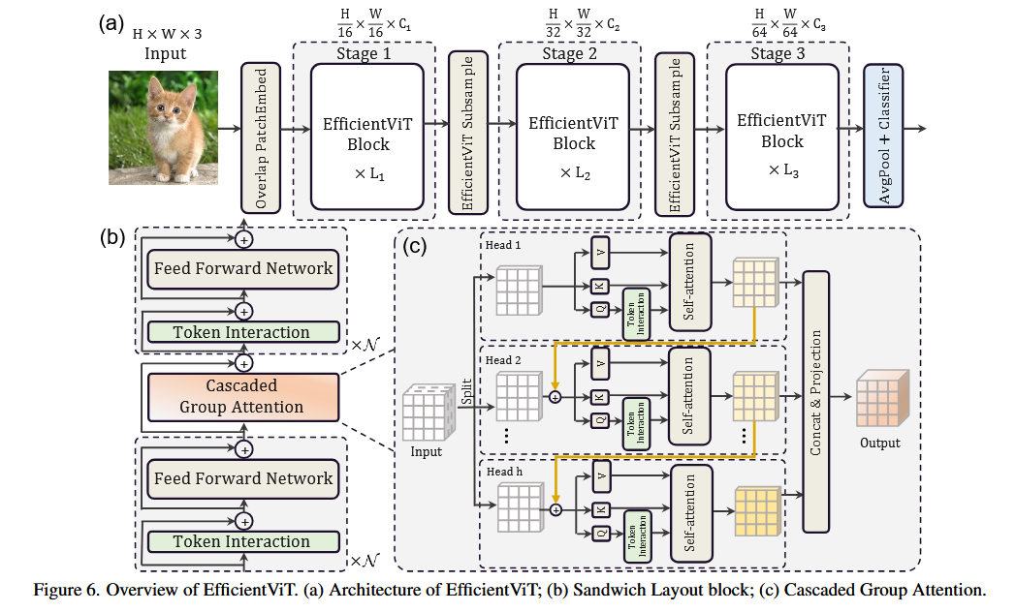

Slide 5
EfficientViT Block – Sandwich Layout
FFN → Self-Attention → FFN
Details:
- Activation: ReLU
- Extra DWConv before FFN
- Memory-efficient design

Slide 6
Sandwich Layout – Part 1
Feedforward neural network
Feed Forward Network
Self-Attention layer
Feed Forward Network
Notes:
Feed Forward Network layer
- Apply an extra token interaction layer before each FFN by using depthwise convolution (DW)

Slide 7
Cascaded Group Attention (CGA)
Input split into h heads
Each head processes a feature split
Q, K, V projections
→ Attention per head
→ Cascaded addition
→ Concatenate outputs
→ Linear projection

Slide 8
Cascade Mechanism
Head j input = X_j + previous head output
X_j' = X_j + X_(j-1)
Improves feature refinement progressively

Slide 9
Parameter Reallocation
- Smaller Q, K dimensions
- Larger V dimension
- FFN expansion ratio reduced (4 → 2)
Goal:
- Improve efficiency
- Keep important channels

Slide 10
EfficientViT Architecture
3 Stages
Each stage:
- Multiple EfficientViT blocks
- Token downsampling (×4)
Components:
- Overlapping Patch Embedding
- Subsampling blocks

Slide 11
EfficientViT Architecture
3 Stages
Each stage:
- Multiple EfficientViT blocks
- Token downsampling (×4)
Components:
- Overlapping Patch Embedding
- Subsampling blocks

Slide 12
Sandwich Layout – Part 1
Feedforward neural network
Feed Forward Network layer
- Apply an extra token interaction layer before each FFN by using depthwise convolution (DW)
Self-Attention layer
Feed Forward Network layer
- Apply an extra token interaction layer before each FFN by using depthwise convolution (DW)

Slide 13
Self-Attention layer – Part 2
(cascaded group attention (CGA))

Slide 16


Slide 17
16x16 Overlap PatchEmbebed
16x16 Overlap Patch Embed
256 x 256 x 28
128 x 128 x 56
64 x 64 x 112
32 x 32 x 224
Probe: 32*16 = 512
3x3 strided Conv
3x3 strided Conv
3x3 strided Conv
3x3 strided Conv
512 x 512 x 3
3x3 kernel
Stride = 2
BN
Activation = ReLU
3x3 kernel
Stride = 2
BN
Activation = ReLU
3x3 kernel
Stride = 2
BN
Activation = ReLU
3x3 kernel
Stride = 2
BN
Activation = ReLU
Notes:
10 - LeViT: a Vision Transformer in ConvNet’s Clothing for Faster Inference:
Nutzen auch „4 layers of 3 × 3 convolutions (stride 2)”
For LeViT, each convolution is followed by a batch normalization
27 - EfficientViT: Memory Efficient Vision Transformer with Cascaded Group Attention
======================================
- ViT zerlegt das Eingabebild in p×p non-overlapping Patches, die als Eingabe für den Transformer-Encoder dienen. Dies wird standardmäßig mit einer p×p-convolution mit Stride p=16 umgesetzt
======================================
32 - Early Convolutions Help Transformers See Better
Convolutional stem details
Our convolutional stem designs use four […] 3×3 convolutions
“The output channel“ is “[64, 128, 128, 256, 256, 512]“#
All 3×3 convolutions are followed by batch norm (BN) [21] and then ReLU [29]

Slide 18
Stage 1
3x3 DW Conv
Feed Forward Network
32 x 32 x 224
32 x 32 x 224
3x3 kernel
Stride = 1
BN (fused)
Activation = ReLU
Stride = 1
Padding = 0
BN (fused)
Activation = ReLU
Fully Connected
Notes:
Batch Normalization
-----------------------
Im Bild wird erwähnt, dass Batch Normalization in Convolution Layers integriert (fused) werden kann
Während des Trainings wird BN normal verwendet (normalisiert die Ausgabe der Convolution), um die Aktivierungen zu stabilisieren.
Wo BN verwendet wird:
- In der Abbildung wird BN klar an den Stellen gezeigt, wo 3x3 Depthwise Convolution vorkommt (Stage 1 bis Stage 3)
- Für andere Schichten, wie die Feedforward Layers, wird BN verwendet, sofern sie keine Self-Attention-Layer sind.
============================================================================
Stage 1 wird L1 (depth=4) mal hintereinander gesetzt
10 - LeViT: a Vision Transformer in ConvNet’s Clothing for Faster Inference:
- The ViT uses layer normalization before each at-
tention and MLP unit
- For LeViT, each convolution is
followed by a batch normalization
- The batch normalization can be merged with the preceding convolution
for inference, which is a runtime advantage over layer
Normalization
27 - EfficientViT: Memory Efficient Vision Transformer with Cascaded Group Attention
28 - MetaFormer Is Actually What You Need for Vision
29 - Rethinking Mobile Block for Efficient Attention-based Models
32 - Early Convolutions Help Transformers See Better
52 - Batch Normalization: Accelerating Deep Network Training by Reducing
Internal Covariate Shift

Slide 19
FFN
Feed Forward Network
Conv2D BN
Conv2D BN
ReLU
Input (batch_size, height, width, ed)
Output (batch_size, height, width, ed)
(1, 32, 32, 224)
(1, 32, 32, 224)
1x1 pointwise convolution
1x1 pointwise convolution
Notes:
Input (batch_size, height, width, ed)
↓
Conv2d_BN (pw1, 1x1, filters=h)
↓ ReLU
Conv2d_BN (pw2, 1x1, filters=ed)
↓
Output (batch_size, height, width, ed)

Slide 20
DownSample 1-2
(1, 16, 16, 336)
Feed Forward Network
Feed Forward Network
Downsample
(32 x 32 x 224)
Input (batch_size, height, width, channels)
Patch Merging
Output (batch_size, height/2, width/2, out_dim)
3x3 DW Conv
3x3 DW Conv
(1, 16, 16, 336)
(1, 32, 32, 224)
(1, 16, 16, 336)
Notes:
00 - SHViT Single-Head Vision Transformer with Memory Efficient Macro Design
To reduce tokens without information loss, we utilize an efficient downsampling layer, which is composed of two stage
1 blocks, with an inverted residual block [27,50,51] (stride-2) placed between them
Auf Deutsch:
- Der Downsampling Layer besteht aus 2 Stages von Typ “Stage 1” mit einem ”inverted residual block” (PatchMerging (strides=2))
================================================
Stage 1
---------
DW Conv + FFN
================================================
2.5 cm
3.3 cm

Slide 21
Patch Merging
Conv2D BN
ReLU
3x3 DW Conv
ReLU
3x3 DW Conv
Output (batch_size, height/2, width/2, out_dim)
Input (batch_size, height, width, channels)
1x1
filters=hid_dim(=dim * 4))
3x3
Depthwise
strides=2
Padding=same
1x1
filters=out_dim
Notes:
Input (batch_size, height, width, channels)
↓
Conv2d_BN (conv1, 1x1, filters=hid_dim)
↓ ReLU
Conv2d_BN (conv2, 3x3, depthwise, strides=2)
↓ ReLU
Squeeze-and-Excitation (SE)
↓
Conv2d_BN (conv3, 1x1, filters=out_dim)
↓
Output (batch_size, height/2, width/2, out_dim)
block1 in : (1, 32, 32, 224)
block1 out: (1, 32, 32, 224)
================================================
### PatchMerging ###
(1, 32, 32, 224)
(1, 16, 16, 336)
==============================
### PatchMerging ###
(1, 32, 32, 224)
(1, 16, 16, 336)
==============================
block2 out: (1, 16, 16, 336)
### PatchMerging ###
(1, 16, 16, 336)
(1, 8, 8, 448)
==============================
### PatchMerging ###
(1, 16, 16, 336)
(1, 8, 8, 448)
==============================
block3 out: (1, 8, 8, 448)

Slide 22
Stage 2
3x3 DW Conv
Single Head Attention
Feed Forward Network
16 x 16 x 336
16 x 16 x 336
Layer Normalization
Group Normalization
ReLU activation
Notes:
Stage 2 wird L2 (depth=7) mal hintereinander gesetzt
Stage 1:
block1 in: (1, 32, 32, 224)
block1 out: (1, 16, 16, 336) [wegen Downsampling → andere Shapes]
Stage 2:
block2 in : (1, 16, 16, 336)
block2 out: (1, 8, 8, 448) [wegen Downsampling → andere Shapes]
Stage 3:
block3 in: (1, 8, 8, 448)
block3 out: (1, 8, 8, 448)
Stage 1:
block1 in : (1, 32, 32, 224)
block1 out: (1, 32, 32, 224)
Stage 2:
block2 in : (1, 32, 32, 224)
### PatchMerging ###
(1, 32, 32, 224)
(1, 16, 16, 336)
==============================
### PatchMerging ###
(1, 32, 32, 224)
(1, 16, 16, 336)
==============================
block2 out: (1, 16, 16, 336)
Stage 3:
block3 in : (1, 16, 16, 336)
### PatchMerging ###
(1, 16, 16, 336)
(1, 8, 8, 448)
==============================
### PatchMerging ###
(1, 16, 16, 336)
(1, 8, 8, 448)
==============================
block3 out: (1, 8, 8, 448)

Slide 23
Single-Head-Attention
em_dim – part_dim (x2)
part_dim (x1)
Identity
x2
C
Output Projection
(1,16,16,336)
(1,16,16,336)
GroupNorm
V
K
Self - Attention
x1‘
Q
Notes:
Input Tensor (B, H, W, dim)
↓
Split along channel dimension: [pdim, dim - pdim]
↓ ↓
x1 (B, H, W, pdim) x2 (B, H, W, dim - pdim)
↓
GroupNorm (x1) → Normalized Tensor
↓
Conv2d_BN → qkv projection
↓
Split into q, k, v tensors:
q: (B, H*W, qk_dim)
k: (B, H*W, qk_dim)
v: (B, H*W, pdim)
↓
Attention computation:
attn = (q @ k^T) * scale
↓
Softmax over attention scores
↓
Weighted sum: v @ attn^T → (B, H*W, pdim)
↓
Reshape to spatial dimensions: (B, H, W, pdim)
↓
Concatenate with x2 (B, H, W, dim)
↓
Projection Layer: ReLU + Conv2d_BN
↓
Output Tensor (B, H, W, dim)

Slide 24
Tensor Shapes
Stages | Shapes | Shapes (with numbers)
Input Tensor | (B,H,W,dim) -> [1,32,32,224] | Batch size = 1, spatial dimensions = 32×32, channels = 224
After Split / Channel Split | x1: (B,H,W,p_dim) -> (1,32,32,48) x2: (B,H,W,dim-p_dim) -> (1,32,32,176) | x1: (pdim=48) x2: (dim−pdim=224−48=176)
GroupNorm on x1 | (B,H,W,p_dim) -> [1,32,32,48] | Normalize x1​ across its 48 channels
QKV Projections | Q: (B,H∗W,qk_dim) -> [1,32,32,48] K: (B,H∗W, qk_dim) -> [1,32,32,48] V: (B,H∗W, p_dim) -> [1,32,32,48] | ~ nochmal nachschauen
Flatten Spatial Dimensions | QKV: [1,1024,48] | Spatial dimensions (32×32 = 1024) are flattened
Attention Scores | (B,H∗W,H∗W) -> [1,1024,1024] | Compute scaled dot-product attention: q @ k^T
Softmax over Attention Scores | (B,H∗W,pdim) -> [1,1024,1024] | Apply Softmax across the last dimension
Weighted Sum | (B,H,W,pdim) -> [1,1024,48] | Attn_score * v^T = attn@v^T
Reshape Weighted Values | [1,32,32,48] | Reshape the outpzt back to spartial dimensions
Concatenated Tensor | (B,H,W,dim) -> [1,32,32,224] | Concatenate the processed x1 [1,32,32,48] with x2​ [1,32,32,176]
Projection Layer / Final Output | (B,H,W,dim) -> [1,32,32,224] | Apply ReLU and Conv2D to combine features into the final output tensor

Slide 25
DownSample 2-3
(1, 8, 8, 448)
Feed Forward Network
Feed Forward Network
Downsample
Input (batch_size, height, width, channels)
Patch Merging
Output (batch_size, height/2, width/2, out_dim)
3x3 DW Conv
3x3 DW Conv
(1, 8, 8, 448)
(16 x 16 x 336)
(1, 16, 16, 336)
Notes:
00 - SHViT Single-Head Vision Transformer with Memory Efficient Macro Design
To reduce tokens without information loss, we utilize an efficient downsampling layer, which is composed of two stage
1 blocks, with an inverted residual block [27,50,51] (stride-2) placed between them
Auf Deutsch:
- Der Downsampling Layer besteht aus 2 Stages von Typ “Stage 1” mit einem ”inverted residual block” (PatchMerging (strides=2))
================================================
Stage 1
---------
DW Conv + FFN
================================================
2.5 cm
3.3 cm

Slide 26
Stage 3
3x3 DW Conv
Single Head Attention
Feed Forward Network
16 x 16 x 336
16 x 16 x 336
Notes:
Stage 2 wird L2 (depth=7) mal hintereinander gesetzt
Stage 1:
block1 in : (1, 32, 32, 224)
block1 out: (1, 32, 32, 224)
Stage 2:
block2 in : (1, 32, 32, 224)
### PatchMerging ###
(1, 32, 32, 224)
(1, 16, 16, 336)
==============================
### PatchMerging ###
(1, 32, 32, 224)
(1, 16, 16, 336)
==============================
block2 out: (1, 16, 16, 336)
Stage 3:
block3 in : (1, 16, 16, 336)
### PatchMerging ###
(1, 16, 16, 336)
(1, 8, 8, 448)
==============================
### PatchMerging ###
(1, 16, 16, 336)
(1, 8, 8, 448)
==============================
block3 out: (1, 8, 8, 448)

Slide 27
Avg Pool
x = torch.nn.functional.adaptive_avg_pool2d(x, 1).flatten(1) +
[Line 222]

Slide 28
Classifier
Line 211 – 215
https://github.com/ysj9909/SHViT/blob/main/model/shvit.py
FFN

Slide 29
Offene Fragen / Todos
Warum wird Patch Merging fürs Downsampling verwendet?
Warum dieser Partial Anteil?
Was macht der Identity Layer?
Was muss ich zu Batch / Group Normalization wissen?
https://github.com/ysj9909/SHViT/blob/main/model/shvit.py

Slide 30
